Slide 1
Fishes Relative Abundance and Diversity of San Martin Lake, TX
Sandra Leal

Slide 2
Background/Introduction
San Martin Lake, TX is a body of water within the Bahia Grande Unit of the Laguna Atascosa National Wildlife Refuge
Bodies of water within the refuge serve as potential nursing grounds
The results obtained from this study may serve as a basis for future studies

Slide 3
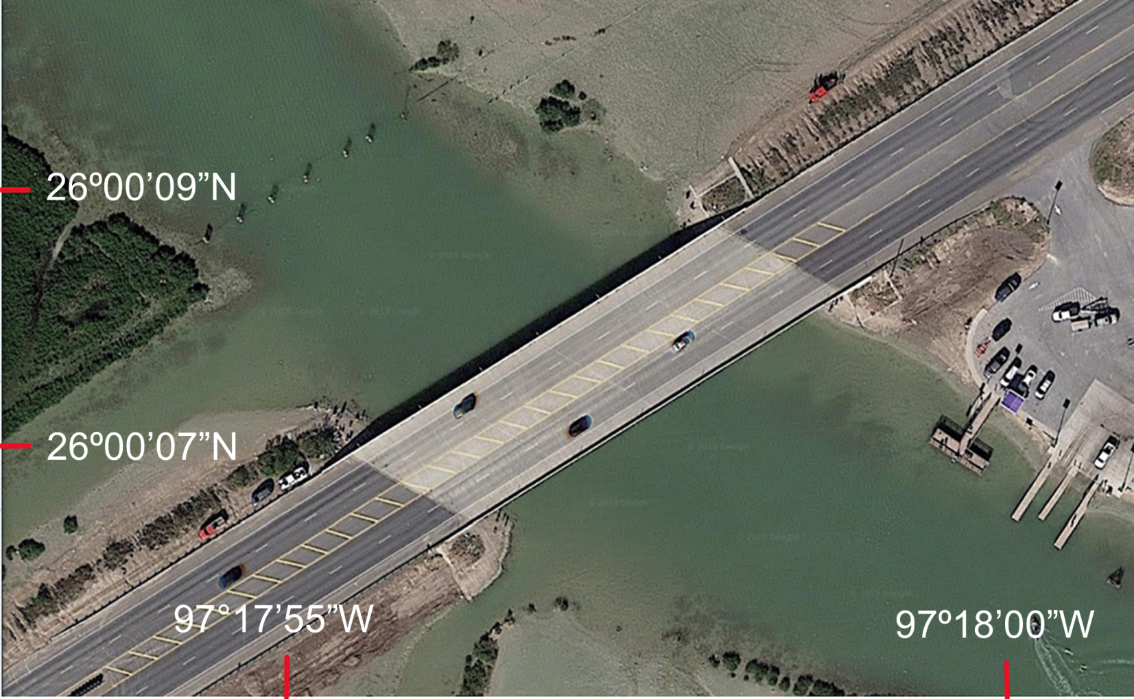
Study Site
Fig.1. San Martin Lake, Tx on Google Maps

Slide 4
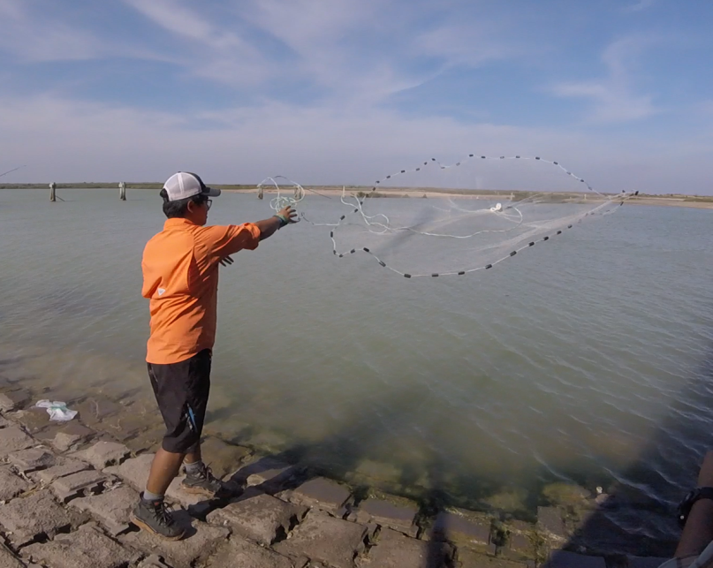
Methods
Sample site divided into gridlets
Sampling using cast net
Data recorded
Data analyzed in PAST3
Fig.2. Performing cast net surveys of SML

Slide 5
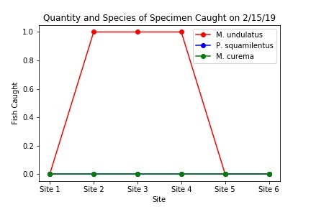
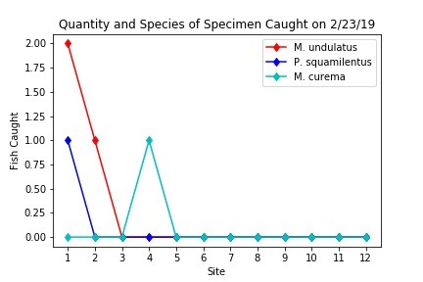
Results
Decrease in amount of individuals collected in the month of March
Increase in species composition
Fig.3-4. Graphs of February Data

Slide 6
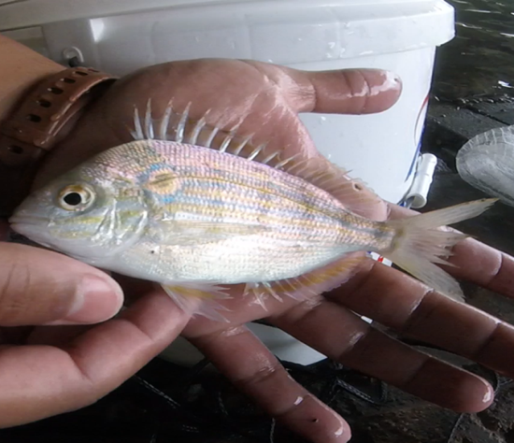
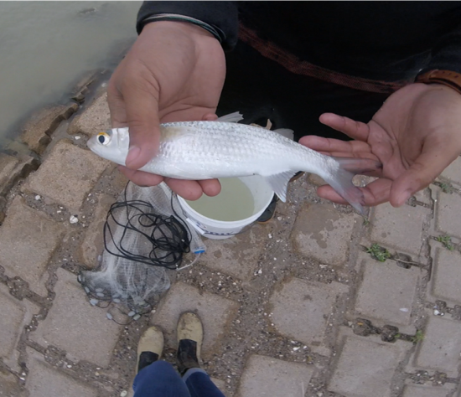
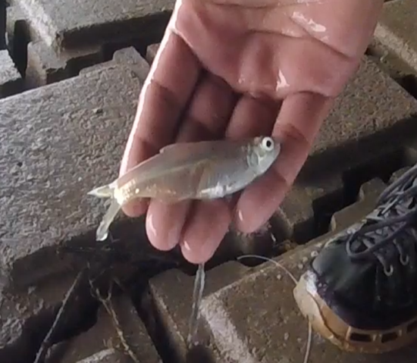
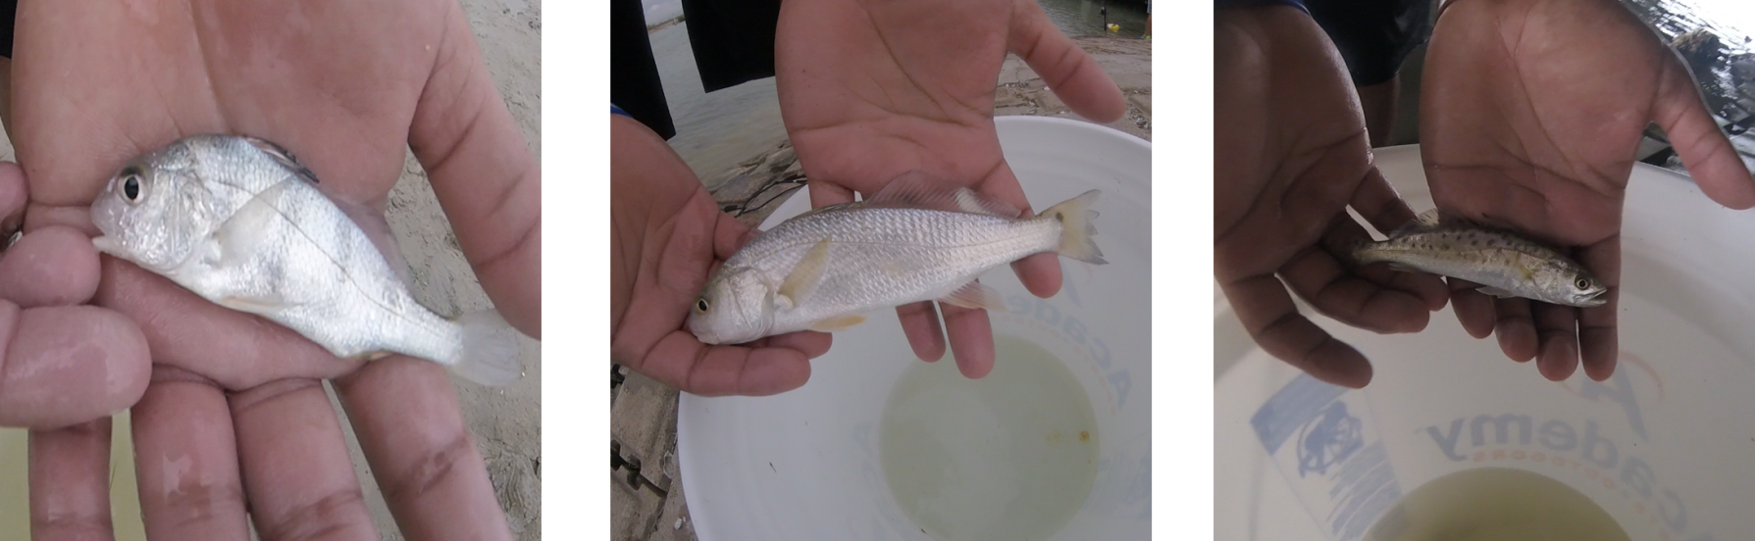
Juvenile Fish Caught
Fig. 5-7. Juvenile Pinfish, Mullet, and Glass Minnow
Fig. 8-10. Juvenile Black Drum, Red Drum, Speckled Trout

Slide 7
Discussion
Statistical analyses revealed no significant differences in:
species richness
relative abundance
diversity
evenness
Between February and March

